Slide 1
Backend Development
NAME : KSHAMA.S
USN : 4SF22CS097

Slide 2
Introduction
The final challenge focuses on developing a Traffic Violation Management System aimed at addressing the growing issue of traffic violations in Mangalore. With increasing incidents like accidents, illegal parking, and other violations, it is crucial to have a system that can monitor and process these events in real-time.
The System designed for this Utilizes following concepts:
Priority queues to prioritize severe violations like accidents over minor offenses.
Stacks to maintain a history of all violations, allowing for easy rollback of wrongly reported incidents.
For proper record-keeping, invoices for fines need to be generated automatically and stored in files. File handling ensures that data is saved, retrieved, and processed effectively for reports and future reference.

Slide 3
Problem Statement
With the growing number of traffic violations in Mangalore, including accidents, illegal parking, speeding, and other offenses, it has become increasingly difficult to manage and monitor these incidents effectively.
The surge in traffic violations not only leads to safety concerns but also contributes to traffic congestion, delays, and environmental issues.
Without a streamlined system, authorities are faced with the challenge of responding to violations promptly, prioritizing urgent matters, and maintaining accurate records.
Thus, there is an urgent need for a system that can monitor traffic offenses as they occur, assess the severity of each violation, and trigger appropriate responses immediately. The system should be able to categorize and process violations efficiently, ensuring that critical incidents are dealt with first, while maintaining accurate records for future reference and analysis.

Slide 4
Solution
System requirements for the project:
1.Programming languages and Frameworks:
Javascript
Node.js
Express.js
2.Data Structures:
Stacks
Priority Queue
3. Databases and File Handling:
JSON
File System (fs module)

Slide 5
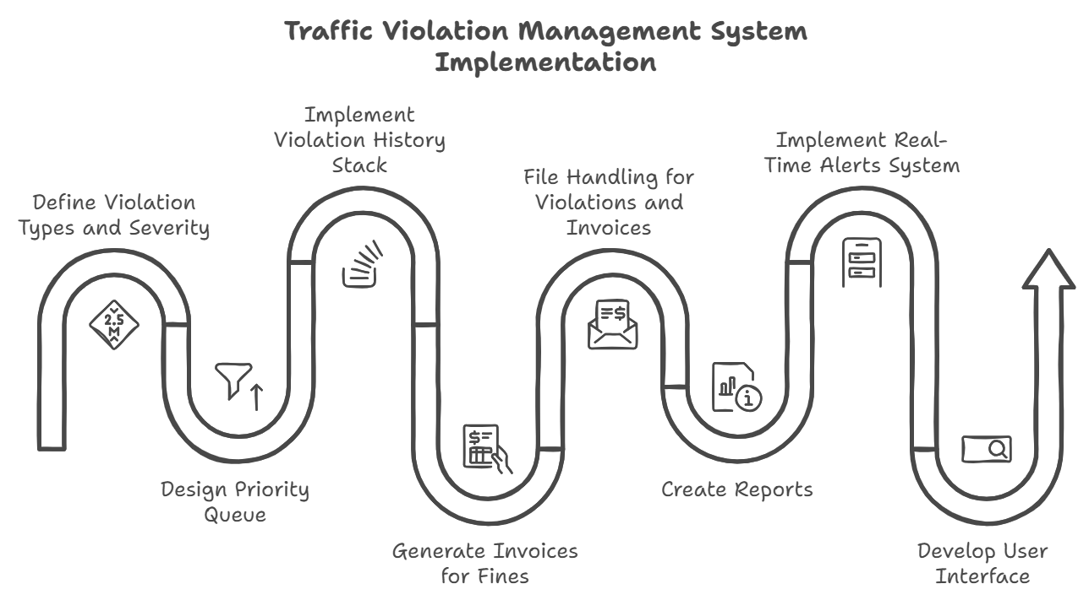
FLOWCHART:

Slide 6
Solut:ion
Backend :
Setup server with Express
Define Routes
Setup Models
Array use case demonstration:
Violation storage
Array Methods like push(to add items),pop(to remove elements),sort,peek.
How are you using Stack and Queue in solving problem:
Stacks are used to store history of violations
Priority Queue is used to store the violation according to their severity so that we can process based on the severity

Slide 7
Solution
Demonstrate Priority factor in problem statement
(Write all the steps of Backend part of the project)
Demonstrate how are you using File handling in problem statement
(Write all the steps of Backend part of the project)

Slide 8
Conclusion
1. The Traffic Violation Management System prioritizes severe incidents, such as accidents, using priority queues to ensure urgent issues are addressed before minor offences like parking violations.
2. Stacks enable history tracking, allowing authorities to undo or correct wrongly reported incidents, enhancing system reliability and accuracy.
3. File handling supports the generation and storage of invoices and detailed reports, aiding in systematic record-keeping for future reference and operational analysis.
4. This system improves traffic management by streamlining enforcement, maintaining accurate records, and supporting better planning, ultimately contributing to safer roads and organized traffic control.

Slide 9
References
Links to external sites, documents, images, videos, articles referred.

Slide 10
Thank You

